Slide 1

Bayesian Learning
Dr. Retno Kusumaningrum, S.Si., M.Kom.

Slide 2
1st ISSUE

Slide 3
Kondisi :
Continuous-valued Data of Single Features (Univariat)
Solusi :
Memodelkan likelihood berdistribusi normal

Slide 4
Contoh Soal :
Terdapat training data berisi 2 jenis buah yaitu apel dan jeruk dengan satu fitur yakni lebar buah. Adapun data-data tersebut seperti dijelaskan pada tabel di samping.
Jika terdapat buah berukuran 2.91”, maka tentukan buah tersebut termasuk jeruk / apel?
Lebar | Buah
2.70” | Jeruk
2.52” | Jeruk
2.57” | Jeruk
2.22” | Jeruk
3.16” | Apel
3.58” | Apel
3.10” | Apel

Slide 5
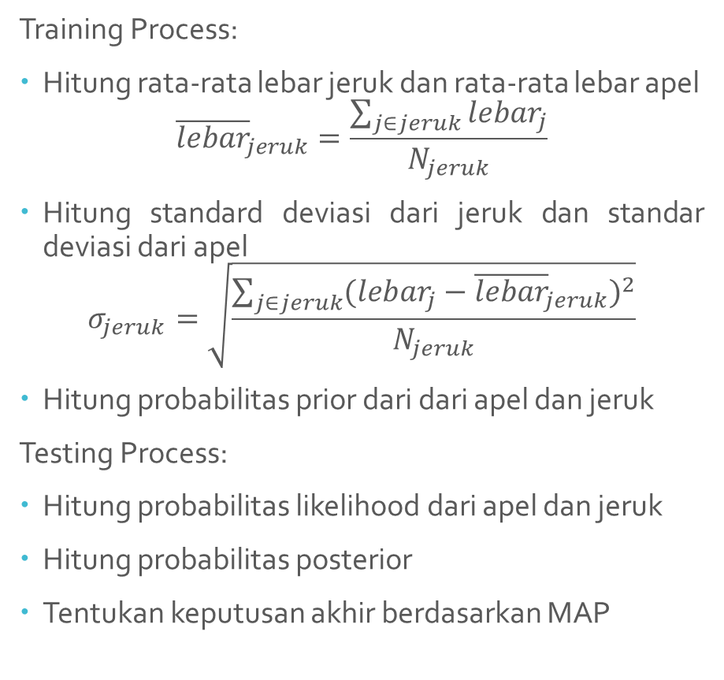
Langkah-langkah penyelesaian
Training Process:
Hitung rata-rata lebar jeruk dan rata-rata lebar apel
$${\overline{lebar}}_{jeruk}=\frac{\sum_{j∈jeruk}{{lebar}_{j}}}{N_{jeruk}}$$
Hitung standard deviasi dari jeruk dan standar deviasi dari apel
$$σ_{jeruk}=\sqrt{\frac{\sum_{j∈jeruk}{{({lebar}_{j}−{\overline{lebar}}_{jeruk})}^{2}}}{N_{jeruk}}}$$
Hitung probabilitas prior dari dari apel dan jeruk
Testing Process:
Hitung probabilitas likelihood dari apel dan jeruk
Hitung probabilitas posterior
Tentukan keputusan akhir berdasarkan MAP

Slide 6
2nd ISSUE

Slide 7
Issue 2 ~ Continuous-valued Data of Multi Features (Multivariat)
Terdapat training data berisi 2 jenis ikan yaitu ikan gurami dan ikan nila dengan dua fitur yakni lebar ikan dan panjang ikan. Adapun data-data tersebut seperti dijelaskan pada tabel di samping.
Jika terdapat ikan berukuran lebar 2.81” dan panjang 5.46”, maka tentukan ikan tersebut termasuk ikan gurami / ikan nila?
Lebar | Panjang | Ikan
2.70” | 3.73” | Nila
2.52” | 3.81” | Nila
2.57” | 3.83” | Nila
2.22” | 3.56” | Nila
3.16” | 3.91” | Gurami
3.58” | 4.04” | Gurami
3.10” | 3.85” | Gurami

Slide 8


Langkah-langkah Penyelesaian
Training Process
Labelling Dataset
$$X=\left[\begin{aligned}\text{2.70 } \text{3.73 } \\ \text{2.52 } \text{3.81 } \\ \text{2.57 } \text{3.83 } \\ \text{2.22 } \text{3.56 } \\ \text{3.16 } \text{3.91 } \\ \text{3.58 } \text{4.04 } \\ \text{3.10 } \text{3.85 }\end{aligned}\right]$$
$$Y=\left[\begin{aligned}1 \\ 1 \\ 1 \\ 1 \\ 2 \\ 2 \\ 2\end{aligned}\right]$$

Slide 9



(Lanjutan)
Memisahkan $X$ berdasarkan kelas
$$X_{1}=\left[\begin{aligned}\text{2.70 3.73} \\ \text{2.52 3.81} \\ \text{2.57 3.83} \\ \text{2.22 3.56}\end{aligned}\right]$$
$$X_{2}=\left[\begin{aligned}\text{3.16 3.91} \\ \text{3.58 4.04} \\ \text{3.10 3.85}\end{aligned}\right]$$

Slide 10

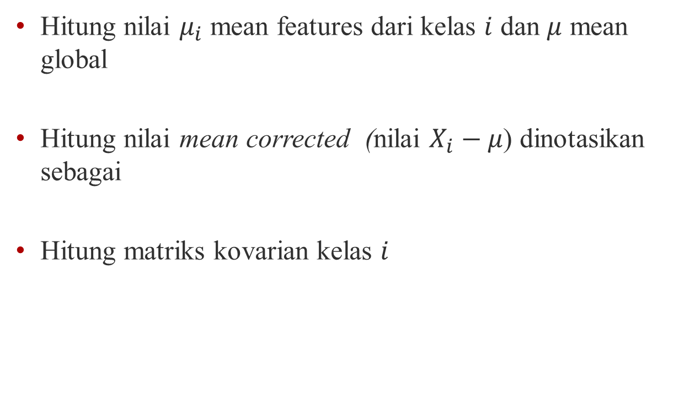

(Lanjutan)
Hitung nilai $μ_{i}$ mean features dari kelas $i$ dan $μ$ mean global
Hitung nilai mean corrected (nilai $X_{i}−μ$) dinotasikan sebagai
Hitung matriks kovarian kelas $i$
$$(X_{i}^{0})$$
$$Σ_{i}=\frac{{(X_{i}^{0})}^{T}X_{i}^{0}}{n_{i}}$$

Slide 11
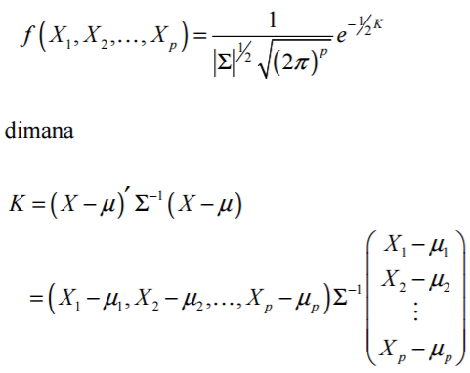
(lanjutan)
Testing Process:
Hitung likelihood dari data

Slide 12
(lanjutan)
Hitung probabilitas posterior
Tentukan keputusan akhir berdasarkan MAP

Slide 13
NAÏVE BAYES

Slide 14
Naïve Bayes
Bayes classification
Difficulty: learning the joint probability
Naïve Bayes classification
Assumption that all input attributes are conditionally independent!
MAP classification rule: for testing data
Notes:
For a class, the previous generative model can be decomposed by n generative models of a single input.

Slide 15

Naïve Bayes
Naïve Bayes Algorithm (for discrete input attributes)
Learning Phase: Given a training set $D$,
Output: conditional probability tables; for elements
Test Phase: Given an unknown instance ,
Look up tables to assign the label $h_{i}$ to $D$’ if

Slide 16
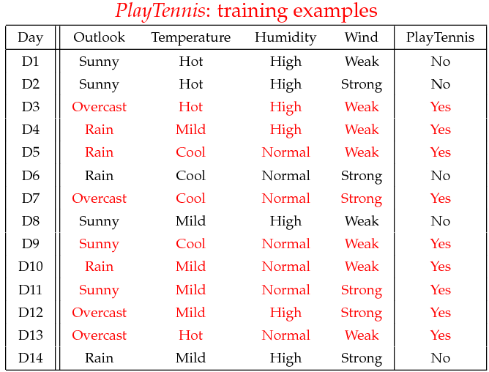
Example
Example: Play Tennis
Bagaimana keputusan akan diambil jika terdapat testing data berupa informasi Outlook=Sunny, Temperature=Cool, Humidity=High, Wind=Weak

Slide 17
Example
Learning Phase
Outlook | Play=Yes | Play=No
Sunny | 2/9 | 3/5
Overcast | 4/9 | 0/5
Rain | 3/9 | 2/5
Temperature | Play=Yes | Play=No
Hot | 2/9 | 2/5
Mild | 4/9 | 2/5
Cool | 3/9 | 1/5
Humidity | Play=Yes | Play=No
High | 3/9 | 4/5
Normal | 6/9 | 1/5
Wind | Play=Yes | Play=No
Strong | 3/9 | 3/5
Weak | 6/9 | 2/5
P(Play=Yes) = 9/14
P(Play=No) = 5/14

Slide 18
Example
Test Phase
Given a new instance,
D’=(Outlook=Sunny, Temperature=Cool, Humidity=High, Wind=Weak)
Look up tables
MAP rule
P(Outlook=Sunny|Play=Yes) = 2/9
P(Temperature=Cool|Play=Yes) = 3/9
P(Humidity=High|Play=Yes) = 3/9
P(Wind=Weak|Play=Yes) = 6/9
P(Play=Yes) = 9/14
P(Outlook=Sunnyt|Play=No) = 3/5
P(Temperature=Cool|Play==No) = 1/5
P(Humidity=High|Play=No) = 4/5
P(Wind=Weak|Play=No) = 2/5
P(Play=No) = 5/14
P(Yes|D’): [P(Sunny|Yes)P(Cool|Yes)P(High|Yes)P(Weak|Yes)]P(Play=Yes) = P(No|D’): [P(Sunny|No) P(Cool|No)P(High|No)P(Weak|No)]P(Play=No) =
Given the fact P(Yes|D’) > P(No|D’), we label D’ to be “Yes”.

Slide 19
ISSUES
RELEVANT TO NAIVE BAYES

Slide 20
Violation of Independence Assumption
Zero conditional probability Problem

Slide 21
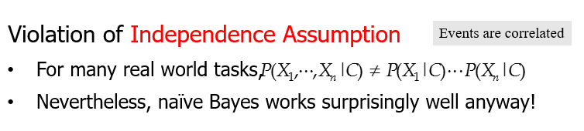

Slide 22
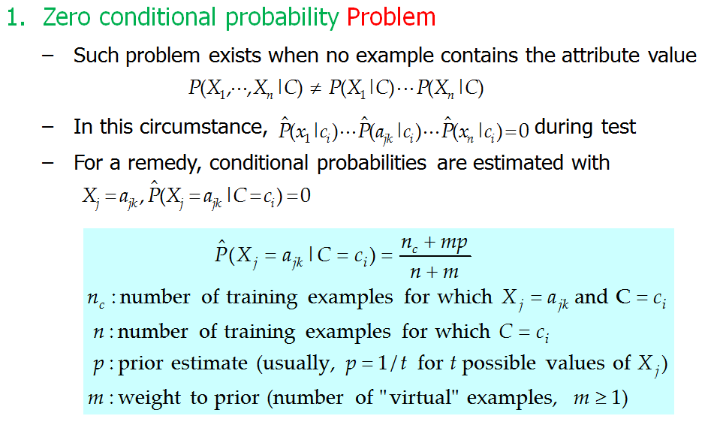

Slide 23
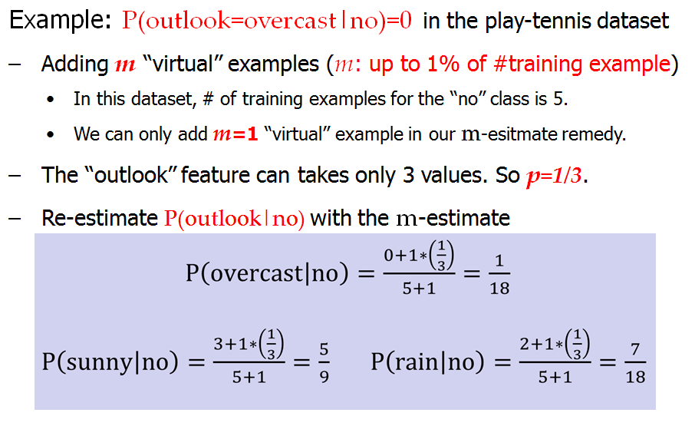

Slide 24
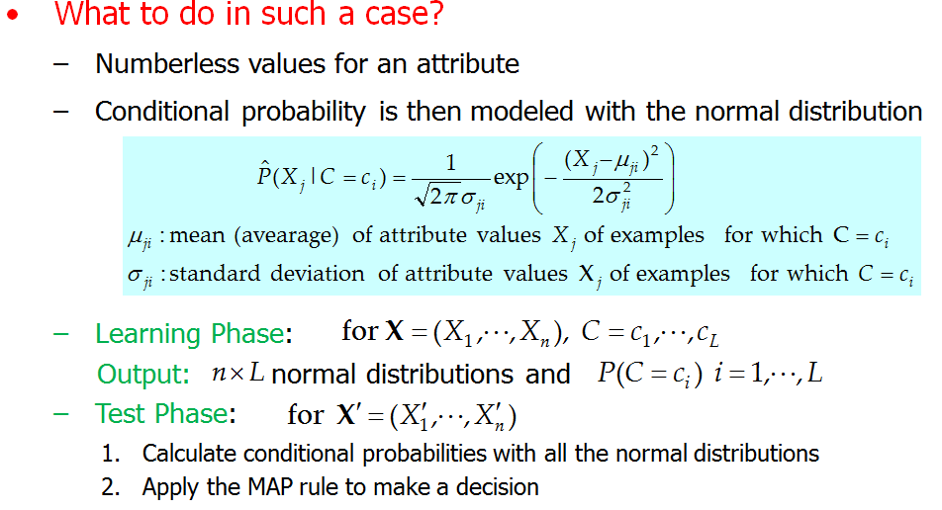
Another Problem Continuous-valued Input Attributes

Slide 25
